Slide 1



DATA ANALYSIS ON
ALCOHOLIC BEVERAGE
TEAM - 10
Shaik Shaheer
Sruthi Kunaparaju
Gaddam Huldah Grace
Mora Sai Charan

Slide 2



Agenda
When specific chemical and sensory properties are taken into
account , to determine the optimum quality.
Tasks
To find out variables which are most significant with respect to target variable
Explore the data distribution of each column to identify some important patterns
Insights and recommendations

Slide 3
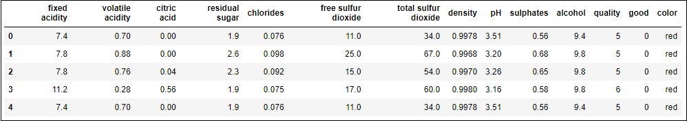


Characteristics of each column
Aroma Flavour Quality Texture Properties
Free sulphur dioxide
Total sulphur dioxide
Alcohol
Fixed acidity
Volatile acidity
Citric acid
Residual sugar
Chlorides
Alcohol
Color
Quality
Good
Density
Sulphates

Slide 4
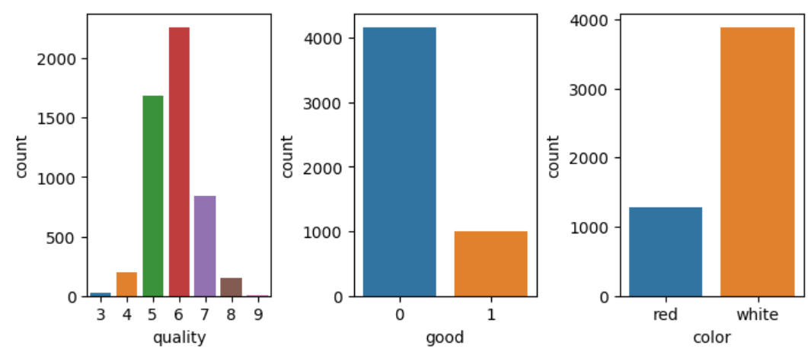
Data Distribution

Slide 5
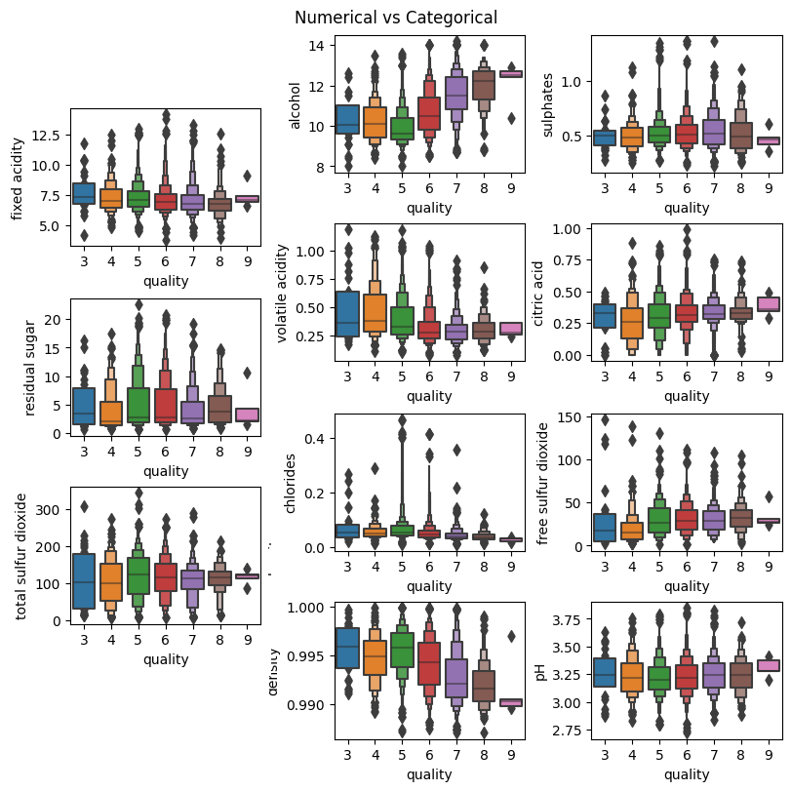
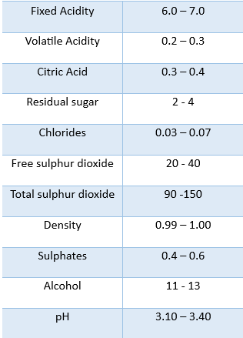

Quality of each feature

Slide 6

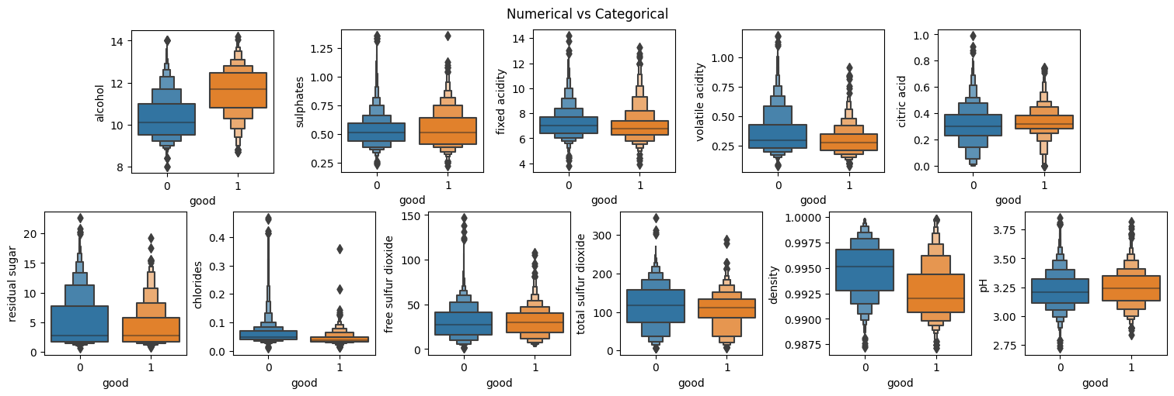
Taste vs each feature
From taste percpective all plots has shown a similar tendency , but taste is affected by ALCOHOL and DENSITY

Slide 7
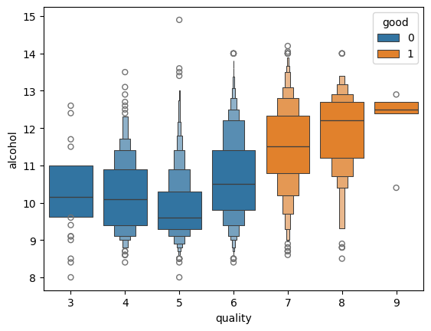
Quality – Taste - Alcohol
As we have seen alcohol is affecting taste. Quality (7 - 9) has mostly provided good taste as their standards are high

Slide 8
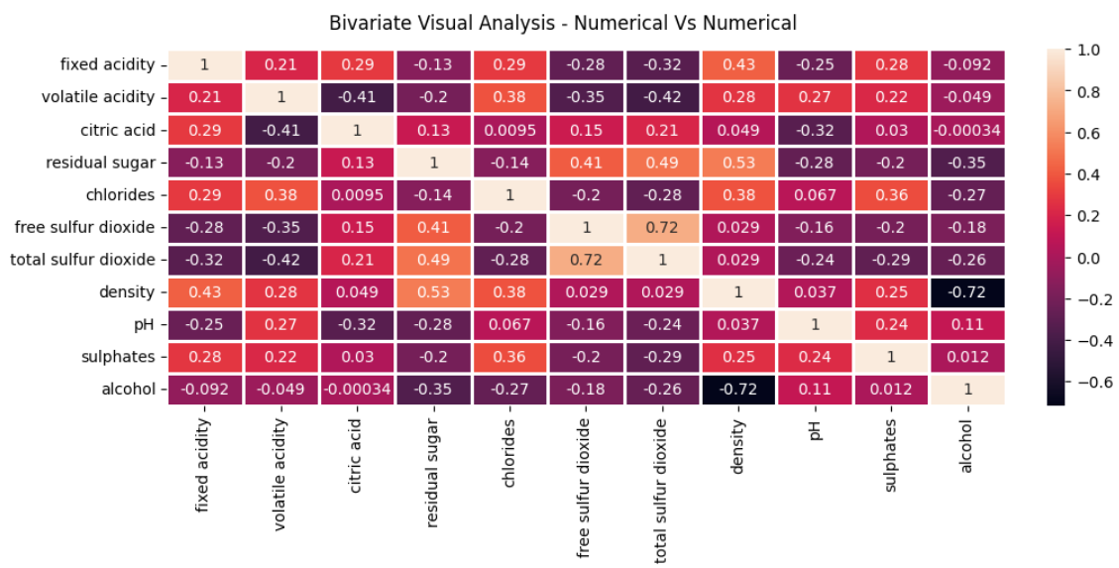
Relation between chemical and sensory properties
Chlorides and Citric acid , Alcohol and Citric acid approximately has no relationship’
Residual Sugars and Density , Free and Total Sulphur dioxide are directly proportional to each other and are having strong relation

Slide 9

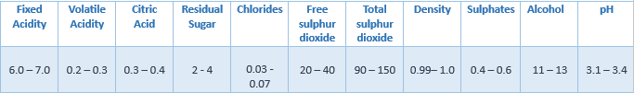
Conclusion
Composition of best wine quality
To be able to target good tasting wines.
ALCOHOL should Increase
DENSITY should Decrease
As the alcohol percentage is increasing , the quality of wine will also increase, which is treated as a GOOD TASTING WINE
Wines having highest quality (considering 7 to 9) have all positive record and preferred color is white.

Slide 10

Disclaimer: consumption of alcohol is injurious to health
Thank You

